Slide 1
P
Axis of rotation
Axis of rotation

Slide 2

Axis of rotation

Slide 3
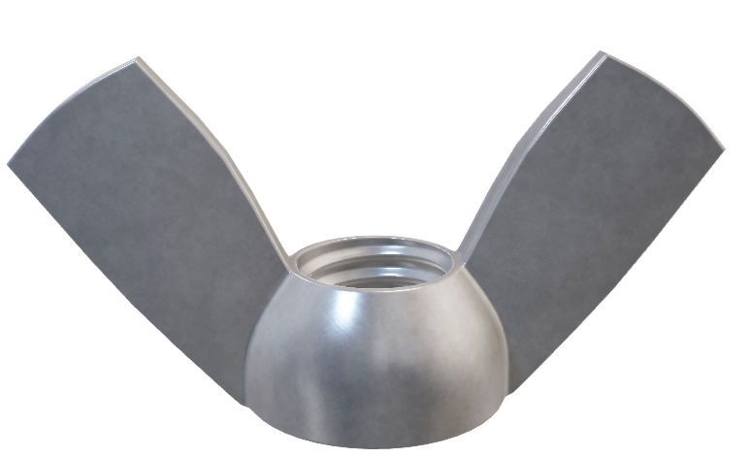



Slide 4
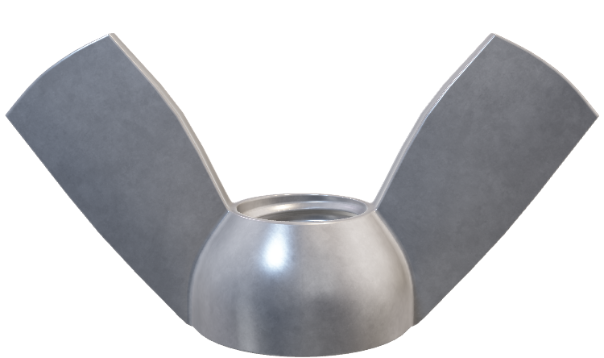
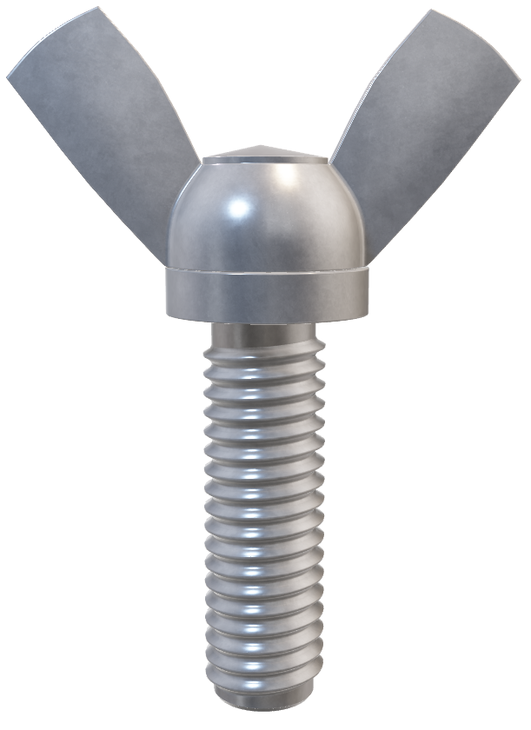

Slide 5
Axis of rotation

Slide 6
Axis of rotation
Axis of rotation

Slide 7
z
L_{CM}
L
CM
x
y
d

Slide 8
Axis of rotation
Axis of rotation

Slide 9
O’
A
O

Slide 10
Axis of rotation

Slide 11
Axis of rotation

Slide 14
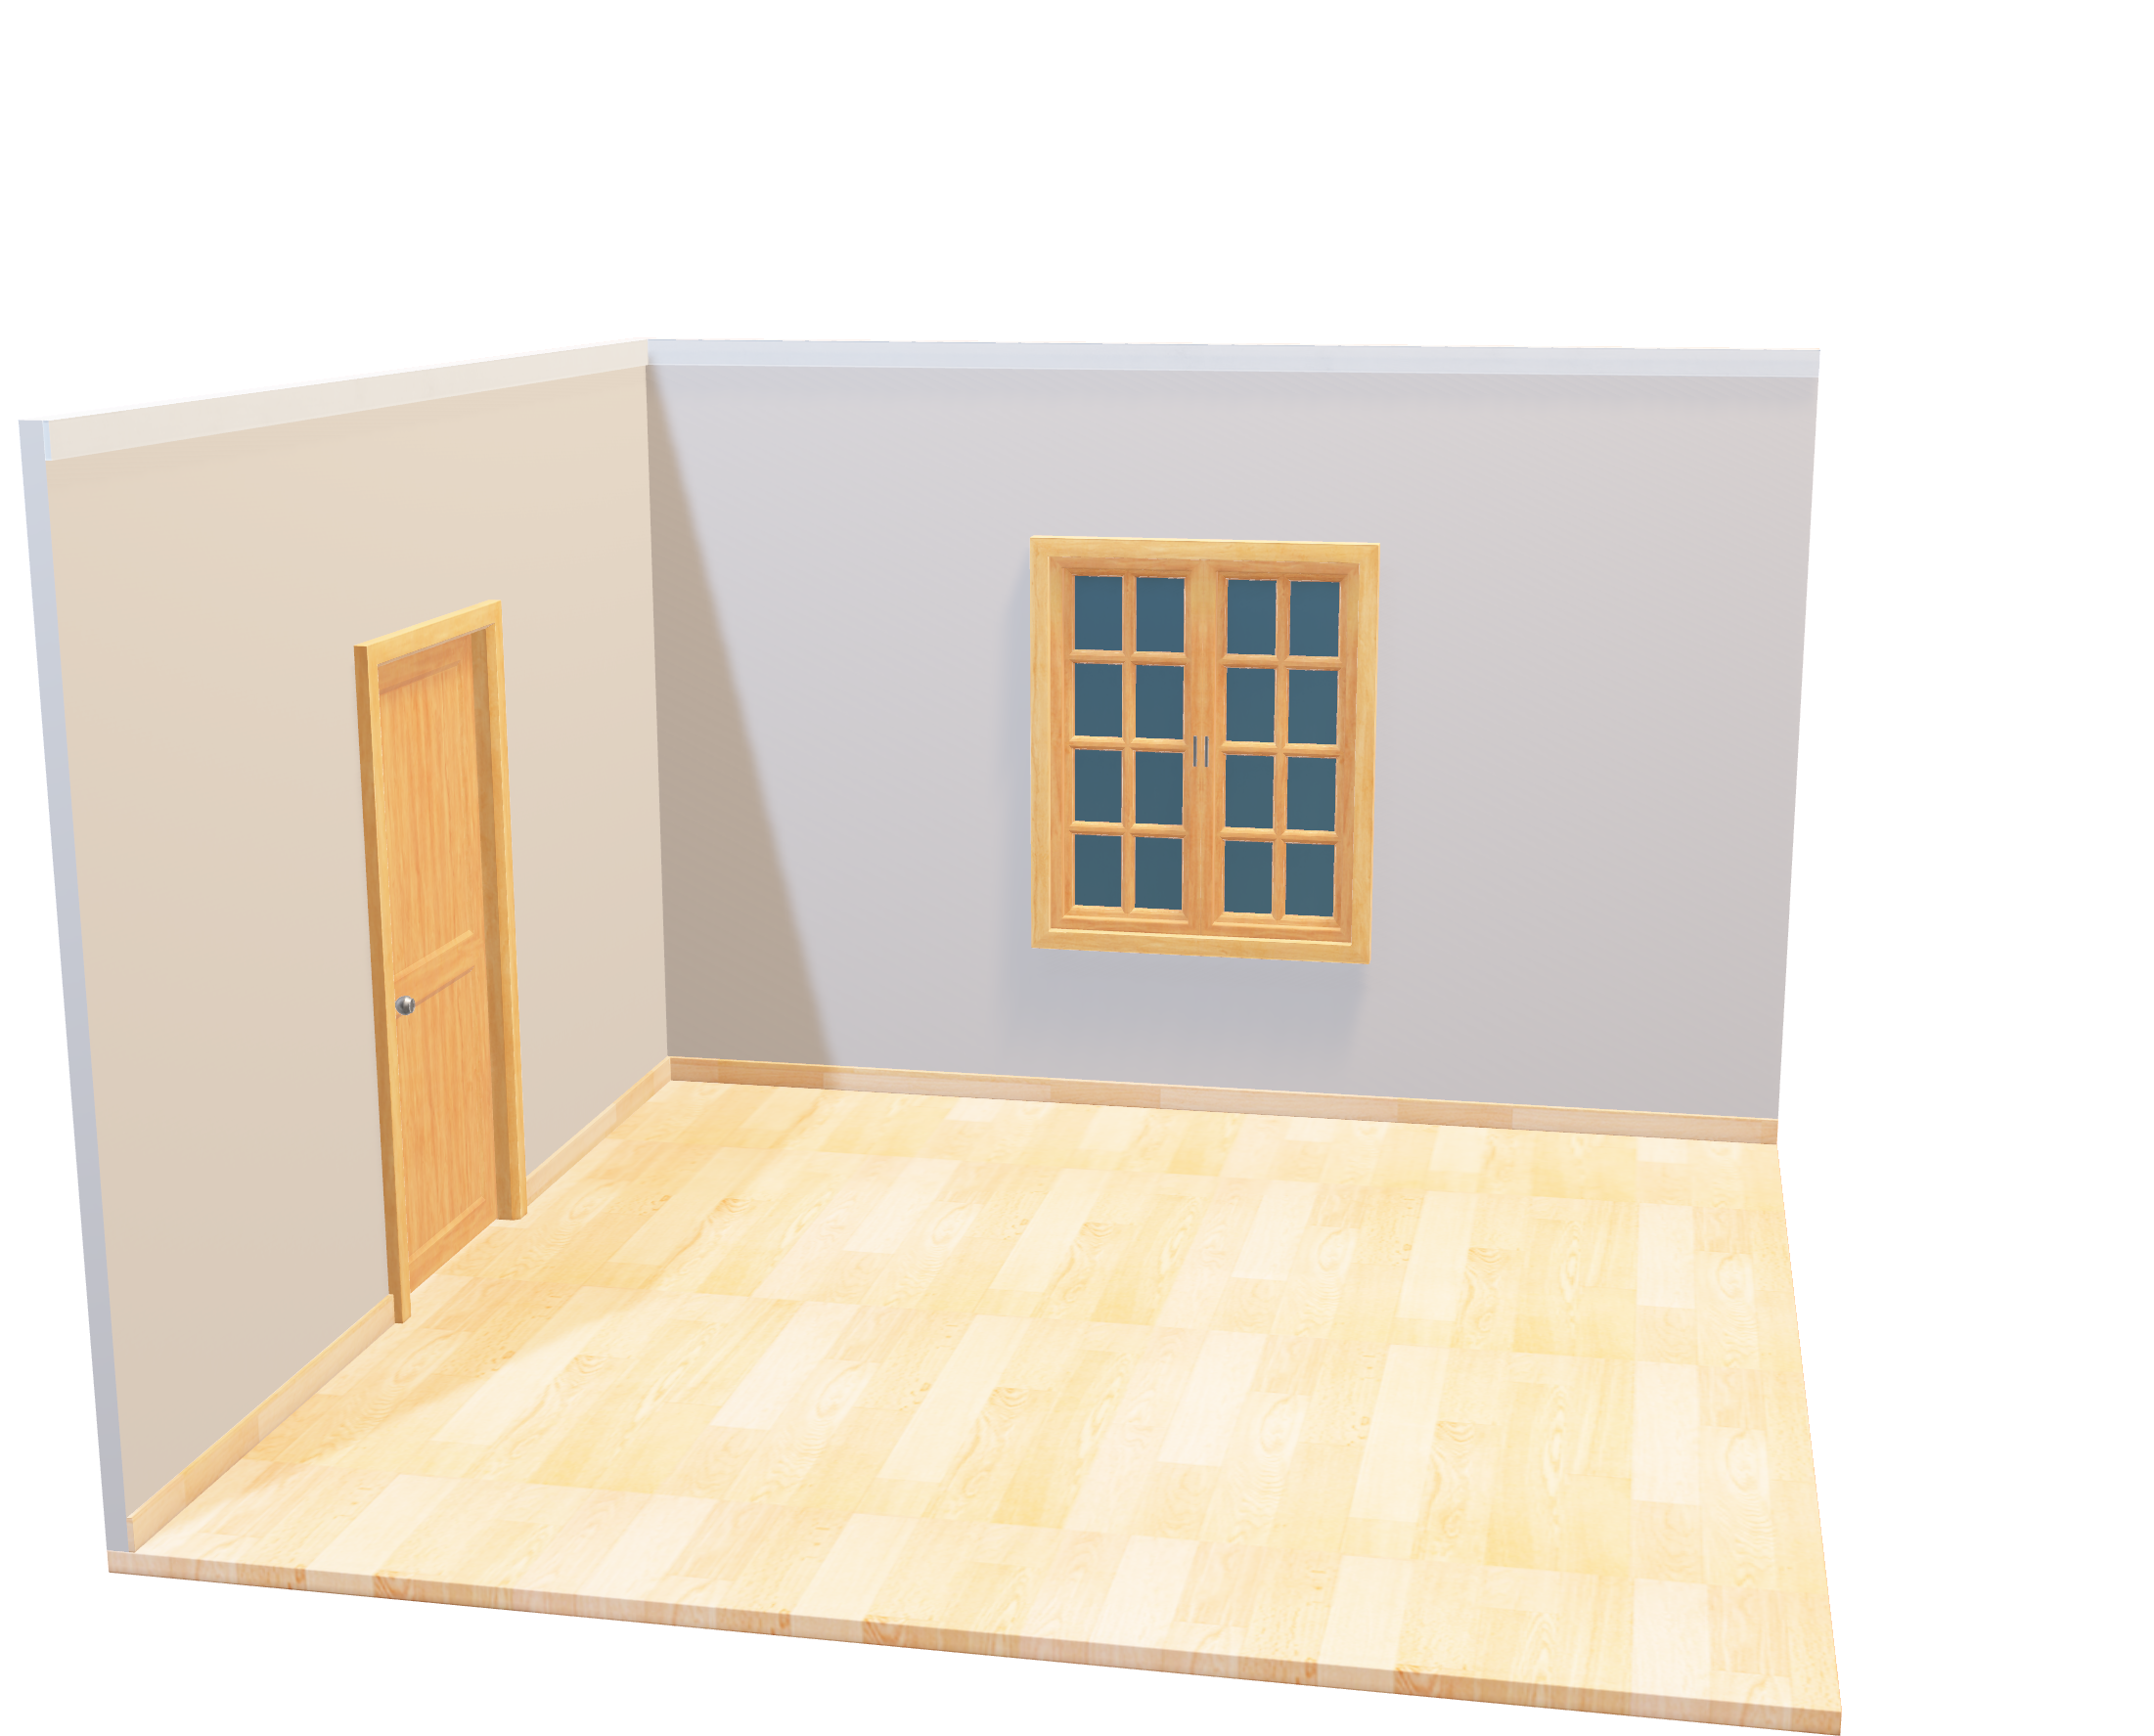
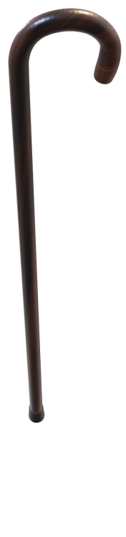

Slide 15
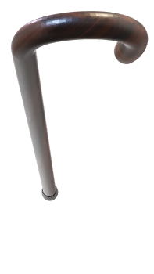

Slide 16
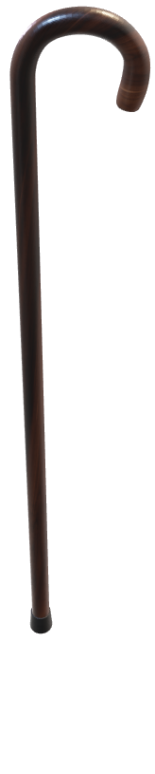

Slide 18
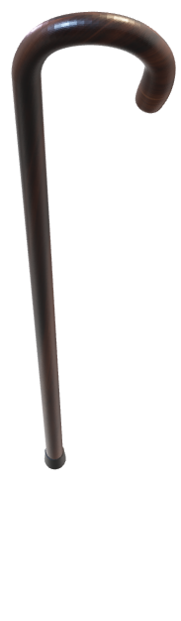

Slide 20
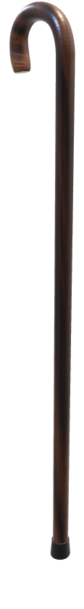

Slide 21
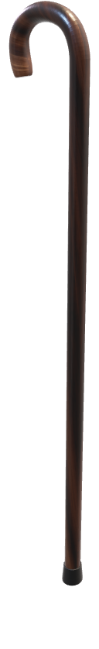

Slide 22


Slide 23
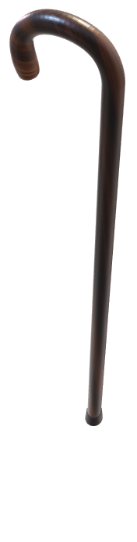

Slide 24
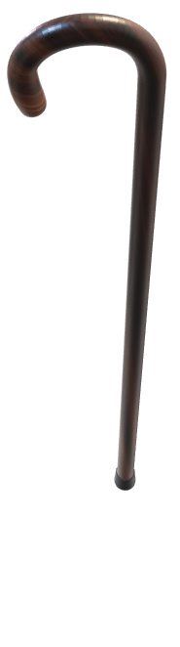

Slide 25
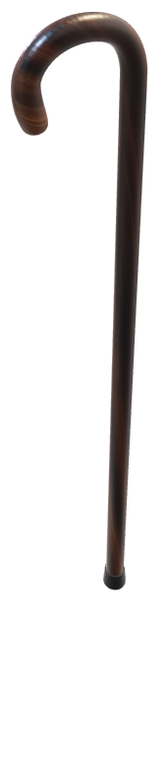

Slide 31


